Slide 1
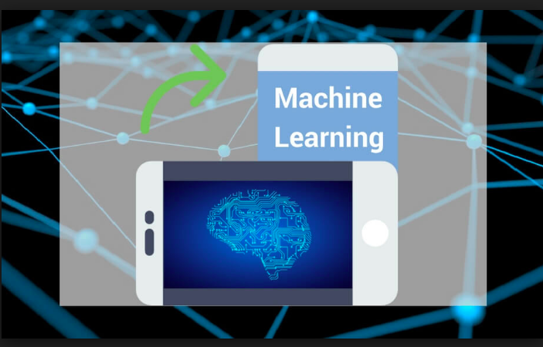
Diagnoses of the disease by Machine Learning Algorithms.
Department: Electronics
Project Guide :- Prof.Sushma Kadge.
Karan Harjai: 1512079
Jay Shah: 1512043

Slide 2
What is Machine Learning?
You probably use it dozens of times a day without even knowing it.Each time you do a web search on Google , that works so well because their machine learning software has figured out how to rank what pages.
When Facebook or Apple's photo application recognizes your friends in your pictures,that's also machine learning.Each time you read your email and a spam filter saves you from having to wade through tons of spam, again,that's because your computer has learned to distinguish spam from non-spam email.
So, that's machine learning.
There's a science of getting computers to learn without being explicitly programmed.
A computer program is said to learn from experience E with respect to some class of tasks T and performance measure P, if its performance at tasks T,as measured by P, improves with experience E."
How do you go about doing that?
Well what you can do is have the robot watch you demonstrate the task and learn from that.The robot can then watch what objects you pick up and where to put them and try to do the same thing even when you aren't there.
For us, one of the reasons excited about this is the AI,artificial intelligence problem.
Many scientists think the best way to make progress on this is through learning algorithms called neural networks, which mimic how the human brain works,

Slide 3

Motivation & Idea
To us it was motivating to learn because finally we could see how all the math we had studied at university is applied in real life, and it's not only interesting, but also very useful.
Also just the thought that given the data you can
extract something useful from it is
already very motivating.
Machine Learning helps us to understand that
instead of writing code, you feed data to the
generic algorithm,and it builds logic based
on the data given.

Slide 4
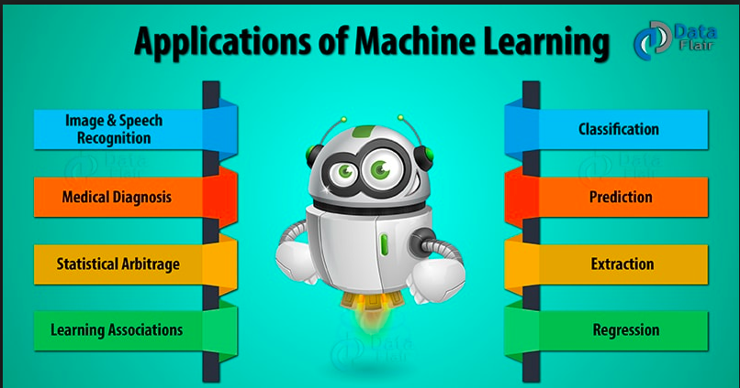

Slide 5

Implementation
We implemented machine learning techniques like logistic regression and Artificial Neural Networks(ANN)
to develop the predictive models.
The main goal was to compare the performance
of these some well-known algorithms
on our data through sensitivity,
specificity, and accuracy.

Slide 6
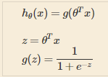
Supervised learning:
1)Regression
Maps input variable to a continuous function.
example-House price prediction.
2)Classification
Maps input variable to a discrete function.
example-Breast cancer prediction.
We started with regression and eventually mapped it to classification using sigmoidal function.

Slide 7
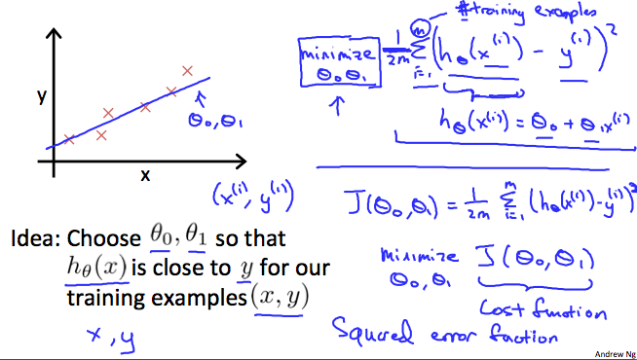

Slide 8
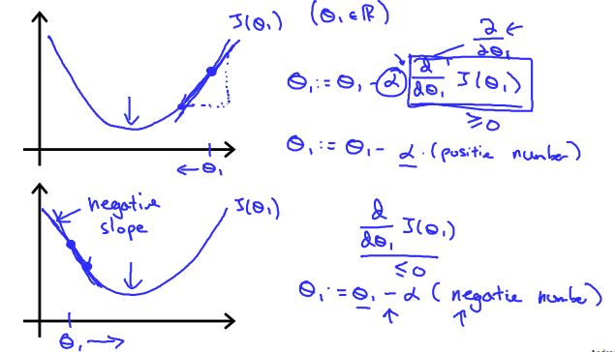

Slide 9
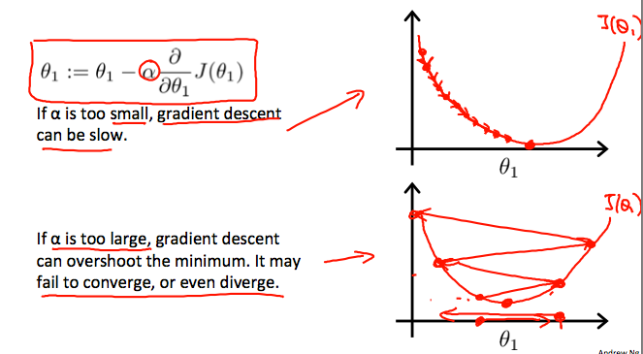
Thumb rule for choosing alpha is start from 0.001,0.003,0.1……. And so on.
Basically choose 3 times the previous value for new one.

Slide 10
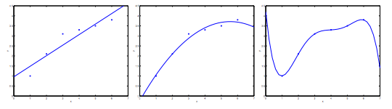
The Problem of Overfitting
a)underfitting b)proper fitting c)Overfitting

Slide 11
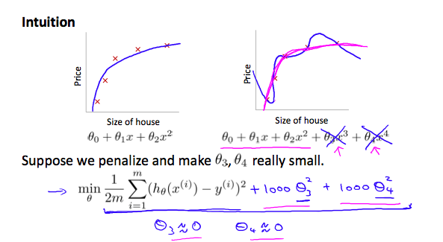

Regularization

Slide 12

Getting Input Variables Roughly in one Range
1)Feature Scaling
Dividing the input values by standard deviation
2)Mean Normalization
Subtracting the average value from each variable

Slide 13
Breast Cancer Tumor Diagnosis - Neural Networks,regression:
The dataset we used is the 'Breast Cancer Wisconsin (Diagnostic) Data Set'. The dataset contains 569 patients with breast tumors. Several measurements and a diagnosis of malignant and benign are available for each patient.
The measurements will be used as features to make our predictions on the diagnosis.In total there are 30 features.

Slide 14
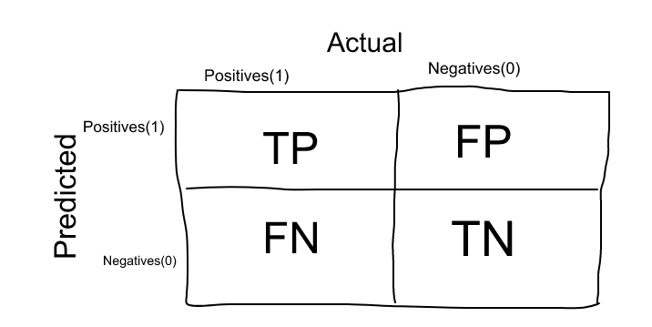
Confusion Matrix

Slide 15
True Positives (TP): True positives are the cases when the actual class of the data point was 1(True) and the predicted is also 1(True)
Ex: The case where a person is actually having cancer(1) and the model classifying his case as cancer(1) comes under True positive.
2. True Negatives (TN): True negatives are the cases when the actual class of the data point was 0(False) and the predicted is also 0(False
Ex: The case where a person NOT having cancer and the model classifying his case as Not cancer comes under True Negatives.

Slide 16
False Positives (FP): False positives are the cases when the actual class of the data point was 0(False) and the predicted is 1(True). False is because the model has predicted incorrectly and positive because the class predicted was a positive one. (1)
Ex: A person NOT having cancer and the model classifying his case as cancer comes under False Positives.
4. False Negatives (FN): False negatives are the cases when the actual class of the data point was 1(True) and the predicted is 0(False). False is because the model has predicted incorrectly and negative because the class predicted was a negative one. (0)
Ex: A person having cancer and the model classifying his case as No-cancer comes under False Negatives.

Slide 17
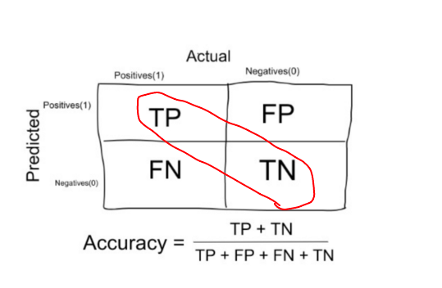
Accuracy
Accuracy is a good measure when the target variable classes in the data are nearly balanced.

Slide 18
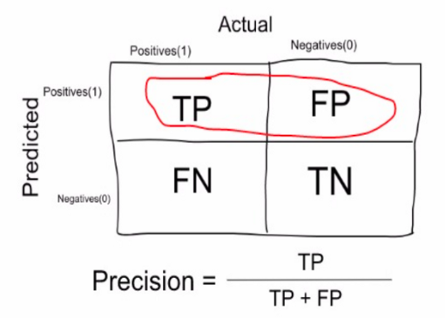
Precision
In our cancer example with 100 people, only 5 people have cancer.
Let’s say our model is very bad and predicts every case as Cancer.
Since we are predicting everyone as having cancer, our denominator(True positives and False Positives) is 100 and the numerator, person having cancer and the model predicting his case as cancer is 5.

Slide 19
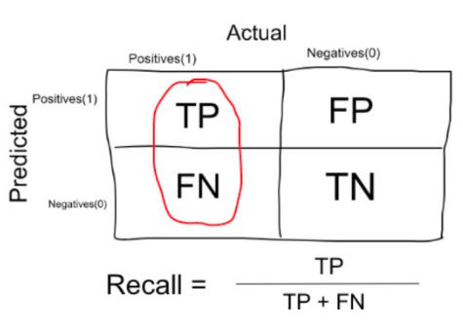
Recall or Sensitivity
In our cancer example with 100 people,
5 people actually have cancer. Let’s say
that the model predicts every case as
Cancer.
So our denominator
(True positives and False Negatives)
is 5 and the numerator, person
having cancer and the model
predicting his case as cancer is also
5(Since we predicted 5 cancer cases
correctly).
So in this example,
we can say that the Recall
of such model is 100%.

Slide 20
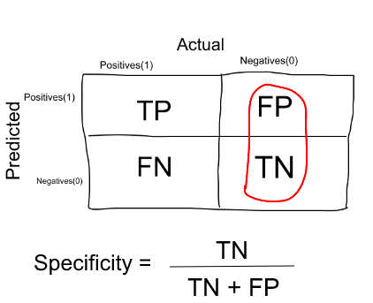
Specificity
In our cancer example with 100 people, 5 people actually have cancer. Let’s say that the model predicts every case as cancer.
So our denominator(False positives and True Negatives) is 95 and the numerator, person not having cancer and the model predicting his case as no cancer is 0 (Since we predicted every case as cancer). So in this example, we can that that Specificity of such model is 0%.

Slide 21
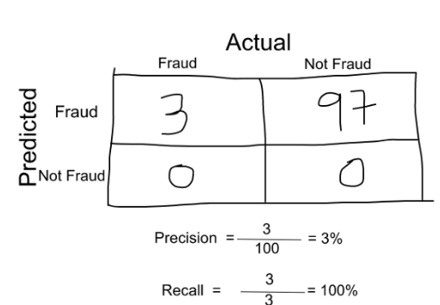
F1 SCORE
One way to do that is simply taking their arithmetic mean. i.e (P + R) / 2 where P is Precision and R is Recall.
F1 Score = 2 * Precision * Recall / (Precision + Recall) = 2*3*100/103 = 5%

Slide 22
Classification | Maximum | Minimum
(logistic regression with batch gradient descent algorithm) | Accuracy: 0.982391 Precision: 0.990909 Sensitivity: 0.962121 Specificity: 0.994365 F1 Score: 0.975934 | Accuracy: 0.977128 Precision: 0.986147 Sensitivity: 0.952814 Specificity: 0.991667 F1 Score: 0.968497
(logistic regression with large-scale optimization algorithm) | Accuracy: 0.980730 Precision: 0.990693 Sensitivity: 0.957576 Specificity: 0.994444 F1 Score: 0.973236 | Accuracy: 0.977067 Precision: 0.985931 Sensitivity: 0.952597 Specificity: 0.991508 F1 Score: 0.968255
Hebbs rule | Accuracy: 0.966632 Precision: 0.938036 Sensitivity: 0.976623 Specificity: 0.960794 F1 Score: 0.956220 | Accuracy: 0.952503 Precision: 0.920273 Sensitivity: 0.961905 Specificity: 0.946905 F1 Score: 0.938534
Perceptron rule | Accuracy: 0.970202 Precision: 0.941629 Sensitivity: 0.981169 Specificity: 0.963651 F1 Score: 0.960758 | Accuracy: 0.940250 Precision: 0.914055 Sensitivity: 0.929004 Specificity: 0.946905 F1 Score: 0.920108

Slide 23
References
Andrew Ng https://www.coursera.org/learn/machine-learning/lecture/6Nj1q/multiple-features.
Principles of Soft Computing by S.N.Sivanndam
S.N.Deepa
https://www.coursera.org/learn/machine-learning/lecture/2DKxQ/normal-equation.
https://www.coursera.org/lecture/assembling-genomes/2011-european-e-coli-outbreak-VgLTB.
https://www.omicsonline.org/using-three-machine-learning-techniques-for-predicting-breast-cancer-2157-7420.1000124.php?aid=13087

